Slide 1
Introduction to Web Development & Web Hosting
Unicom TIC
6th April 2024

Slide 2
Prerequisites
Interested in learning software development
Have ever seen/used any software or website

Slide 3
Learning Objectives
Understand the types of software
Understand the process of software development
Understand the concept of web development
Understand the tools and technologies used for web development
NOT Covered: System Software, Programming Software & embedded

Slide 4

What is software development?
Set of computer science activities that are dedicated to the process of creating, designing, deploying, and supporting software.

Slide 5
What do you mean by a Software?
Software itself is the set of instructions or programs that tell a computer what to do.
It is independent of hardware and makes computers programmable.
There are three basic types:

Slide 6
Types of Software
System software to provide core functions such as operating systems, disk management, utilities, hardware management and other operational necessities.
Programming software to give programmers tools such as text editors, compilers, linkers, debuggers, and other tools to create code.
Application software (applications or apps) to help users perform tasks. Office productivity suites, data management software, media players and security programs are examples. Applications also refer to web and mobile applications like those used to shop on Amazon.com, socialize with Facebook or post pictures to Instagram.

Slide 7
Types of software
A possible fourth type is embedded software
is used to control machines and devices not typically considered computers — telecommunications networks, cars, industrial robots and more. These devices, and their software, can be connected as part of the Internet of Things (IoT).

Slide 8
Steps in the software development process
Selecting a methodology
Gathering requirements
Choosing or building an architecture
Developing a design
Building a model
Constructing code
Testing
Managing configuration and defects
Deploying
Migrating data
Managing and measuring the project
Notes:
Selecting a methodology to establish a framework in which the steps of software development are applied. It describes an overall work process or roadmap for the project. Methodologies can include Agile development, DevOps, Rapid Application Development (RAD), Scaled Agile Framework (SAFe), Waterfall, and others.
Gathering requirements to understand and document what is required by users and other stakeholders.
Choosing or building an architecture as the underlying structure within which the software will operate.
Developing a design around solutions to the problems presented by requirements, often involving process models and storyboards.
Building a model with a modeling tool that uses a modeling language like SysML or UML to conduct early validation, prototyping, and simulation of the design.
Constructing code in the appropriate programming language. Involves peer and team review to eliminate problems early and produce quality software faster.
Testing with pre-planned scenarios as part of software design and coding — and conducting performance testing to simulate load testing on the application.
Managing configuration and defects to understand all the software artifacts (requirements, design, code, test) and build distinct versions of the software. Establish quality assurance priorities and release criteria to address and track defects.
Deploying the software for use and responding to and resolving user problems.
Migrating data to the new or updated software from existing applications or data sources if necessary.
Managing and measuring the project to maintain quality and delivery over the application lifecycle, and to evaluate the development process with models such as the Capability Maturity Model (CMM)

Slide 9

What is Website?
Imagine the internet as a huge library filled with information.
Now, think of a website as a book in that library
Notes:
Now, think of a website as a book in that library. Just like a book contains pages with text, images, and sometimes even interactive elements.
A website consists of web pages that you can access using a computer, tablet, or phone connected to the internet.
Each web page on a website is like a chapter in a book.
These pages are connected together, allowing you to navigate from one to another through links.
For example, when you click on a link or type a web address (also called a URL) into your web browser, you're essentially opening a specific page on a website.

Slide 10
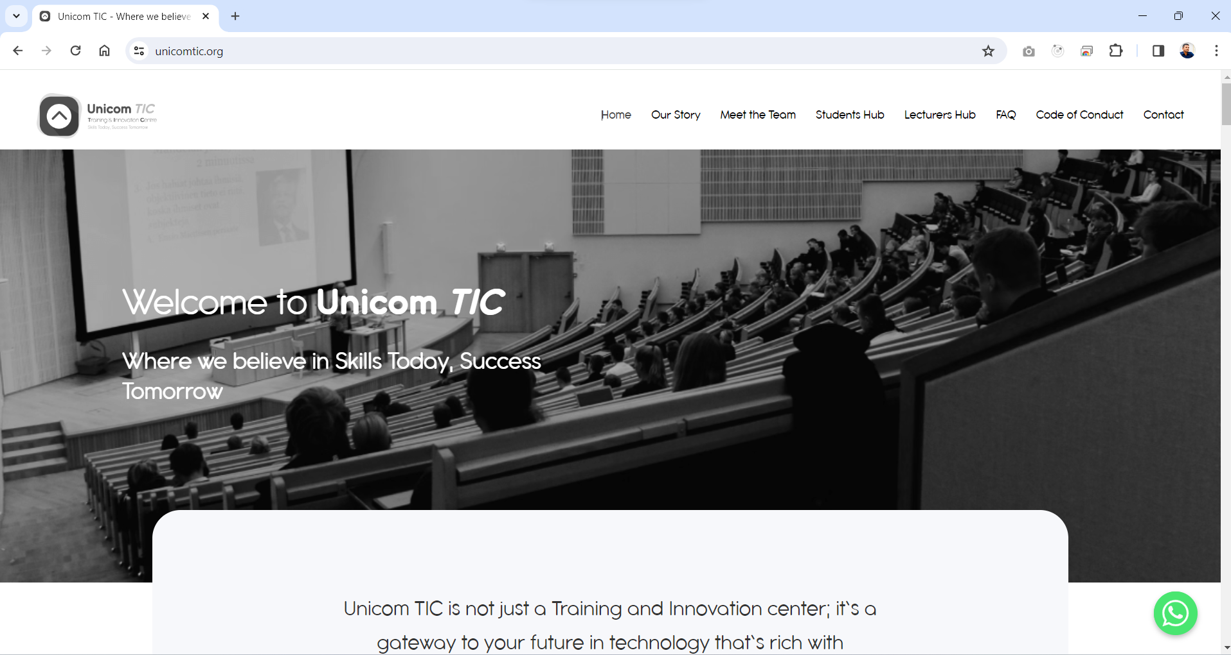
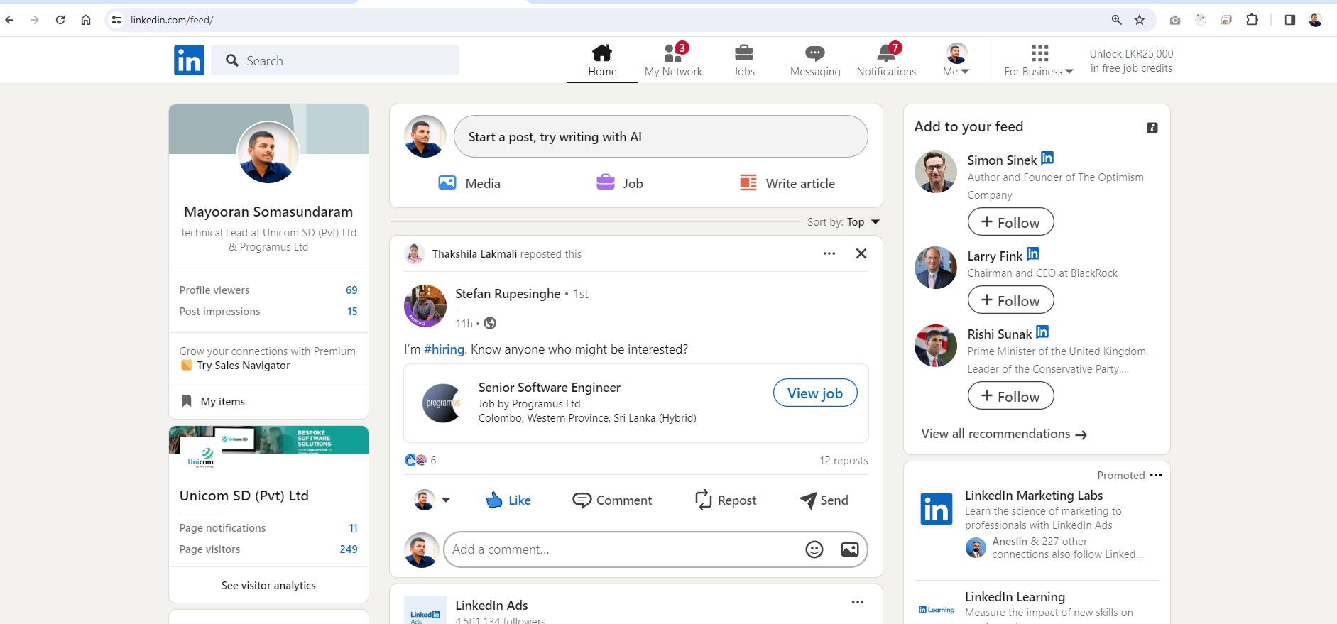

Slide 11
Types of Website
Static Website: Web pages are returned by the server which are prebuilt source code files.
(Website)
Dynamic Website: Web pages are returned by the server which is processed during runtime means they are not prebuilt web pages, but they are built during runtime according to the user’s demand with the help of server-side scripting languages
(Web Application)

Slide 12
Web development
The process of creating websites and web applications, encompassing everything from designing the layout and user interface to coding the functionality that powers them.
It involves a combination of programming languages, frameworks, and tools to bring a website or web application to life.

Slide 13
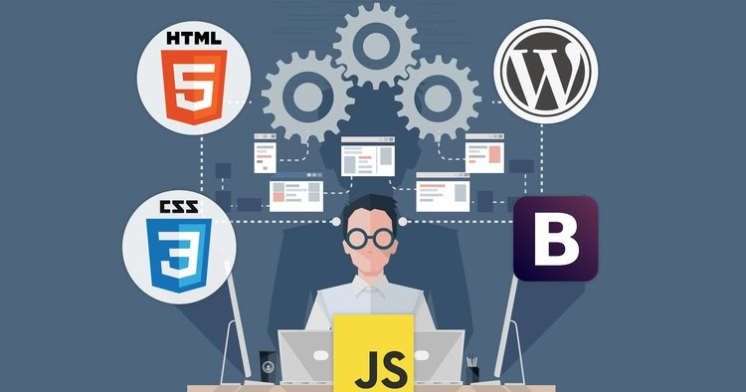
Frontend Development
Frontend development focuses on the client-side of web applications.
It deals with the presentation layer, including HTML, CSS, and JavaScript.
Frontend developers ensure that websites are visually appealing, responsive, and interactive.

Slide 14
Backend Development
Backend development involves server-side programming.
It deals with the logic, database interactions, and server configuration.
Backend developers ensure that websites function smoothly, handle user requests efficiently, and maintain data integrity.

Slide 15
Full Stack Development
Full stack developers are proficient in both frontend and backend development.
They possess a broad skill set, enabling them to handle all aspects of web development.
Full stack developers play a crucial role in building end-to-end web solutions

Slide 16
Core Technologies
HTML (Hypertext Markup Language): Defines the structure of web pages.
CSS (Cascading Style Sheets): Styles the layout and appearance of web pages.
JavaScript: Adds interactivity and dynamic behaviour to web pages.
Additional technologies: Frameworks like Angular, React, Vue.js, and libraries like jQuery enhance development efficiency.

Slide 17
Backend Technologies
Server-side programming languages: Examples include JavaScript (Node.js), C# (.Net Core) Python (Django, Flask), Ruby (Ruby on Rails), PHP (Laravel), and Java (Spring Boot).
Databases: SQL databases (Microsoft SQL Server, MySQL, PostgreSQL) and NoSQL databases (MongoDB, Redis) store and manage data.
Web servers: Apache, Nginx, and Microsoft IIS handle HTTP requests and responses

Slide 18
Development Tools
Integrated Development Environments (IDEs): Visual Studio Code, Atom, Sublime Text provide features for coding, debugging, and version control.
Version Control Systems (VCS): Git enables collaboration, code management, and version tracking.
Package Managers: npm (Node Package Manager) and pip (Python Package Index) simplify dependency management.

Slide 19
Best Practices
Responsive Design: Ensure websites adapt to various screen sizes and devices.
Performance Optimization: Minimize load times through efficient coding, asset optimization, and caching strategies.
Accessibility: Make websites usable for people with disabilities by adhering to WCAG guidelines.
Security: Implement measures such as HTTPS, input validation, and authentication to protect against cyber threats.
Notes:
Web Content Accessibility Guidelines

Slide 20

Conclusion
Web development is a dynamic and multifaceted field that continues to evolve.
By understanding its core principles, technologies, and best practices, you can embark on a rewarding journey of building innovative web solutions.
Thank you.

